Slide 1
ACCELERATING
TECHNOLOGY DELIVERY

Slide 2
Friction is the Enemy: Why Centralized Delivery Feels Slow
Section heading (top): Centralized IT Delivery (Budgeted, Staffed, Planned in Batches)
Top flow step 1: Budget requests (pre-FY)
Top flow step 3: Capacity staffed (FY+2 mo)
Top flow step 5: Re-discovery (FY+4 mo)
Top flow step 7: PI planning / scheduling
Top flow step 8: Build → QA → release
Top flow step 9: Rework loop
Top flow step 2 (waiting): Waiting
Top flow step 4 (waiting): Waiting
Top flow step 6 (waiting): Waiting
Top net callout: Net: 9–12 months to usable value. Misalignment drives rework.
Section heading (bottom): Embedded Pod + Hub Guardrails (Continuous Delivery)
Bottom flow step 1: Capacity funded to the business
Bottom flow step 2: Kanban: build in small increments
Bottom flow step 3: Automated guardrails (tests, policy-as-code)
Bottom flow step 4: Direct feedback loop
Bottom net callout: Net: weeks to value. Less translation. Faster learning.

Slide 3
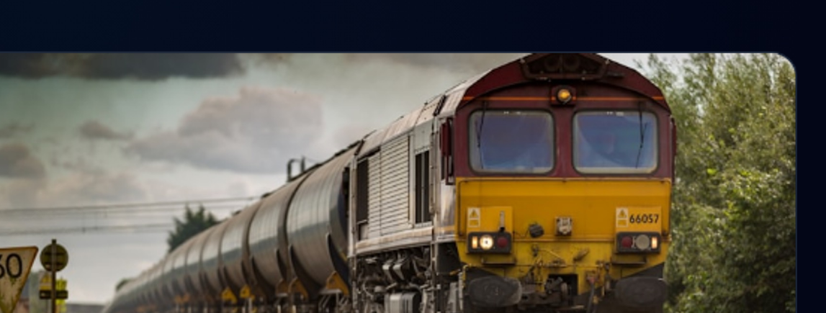
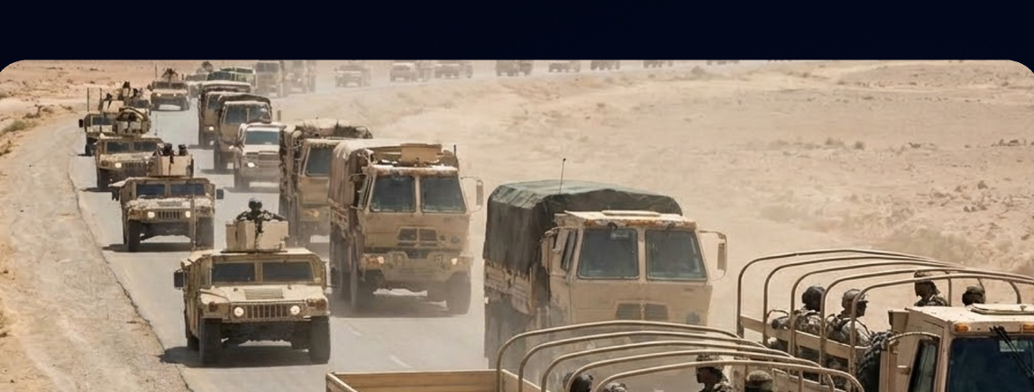
Comparing Development Models
The Freight Train (Scaled Agile)
Best For: ERP & Back-Office Stability.
Why: Efficient when the destination is known and the route is stable. Optimized for batching and predictability.
The Convoy (Fusion/Pods)
Best For: Innovation & External Products.
Why: Necessary when terrain is uncertain. Small, autonomous units that can re-route instantly based on feedback.

Slide 4
The Operating Model: Hub-and-Spoke

Slide 5

The Hub: Enablement & Supply
Enablement over Control
The Tooling Mix: Provide seamless access to best-in-class tools (BigQuery, Databricks, Cloud Run) without bureaucratic friction.
Automated Governance: Quality checks are baked into the pipeline (Protect, Measure, Enforce), replacing manual review gates.
Golden Paths: Pre-secured templates for BTs and Fusion Teams to start building immediately.
"Make the Right Way, the Easy Way."

Slide 6
Spokes: Low to Medium Complexity
Divider line (thin): spans across under title
Card (Left): The Business Technologist
Role: Domain Expert (e.g., Supply Chain Analyst) using AI agents and low-code tools.
Focus: Rapid prototyping of local business logic. “Vibe coding” allows them to build 80% of the solution instantly.
Card (Right): The Analytics Team
Composition: Small squad of Business Technologists + Analytics Lead.
The “Analytics Lead”: The Semantic Modeler. Unlike Data Engineers who move raw data, the AE uses tools like Dataform to create data modeling pipelines that build the core data models used for analysis & ML.
Icon (Left card, cyan person/robot outline)
Icon (Right card, purple analytics/chart)

Slide 7
Spokes: Medium to High Complexity
Left card container (rounded rectangle)
Right card container (rounded rectangle)
Left card header: icon (group/people) + "The Fusion Team"
Right card header: icon (helmet) + "Forward Deployed Team"
Left card body text:
Where: Internal IT / Product.
Model: Lightweight, cross-functional squads (4-5 utility players). Faster than SAFe, less dense than a Forward Deployed Team.
Use Case: Building scalable, multi-tenant Enterprise SaaS products.
Right card body text:
Where: Embedded with Client / Complex Business Area.
Model: Elite, high-talent density. The "Special Ops" approach.
Use Case: Only for high-ROI, "messy" problems where being on-site is the only solution. Solutions are "extracted" back to the platform.

Slide 8
Formalizing the Business Technologist Vertical
Background (dark navy gradient)
Divider line under title (thin, subtle)
Right diagram outer panel (rounded rectangle, very dark, subtle border)
Section header (purple): The "Third Vertical"
Body text: Establishing a professional home for technologists who sit outside of
traditional Engineering but drive technical value.
Pillar: Business Technologist (purple, tallest) + person icon + labels 'Business' and 'Technologist'
Left card container (rounded rectangle, dark slate, purple left accent strip)
Card title (purple): The Career Ladder
Pillar: Product (grey, medium height) + icon + label
Pillar: Engineering (grey, medium height) + code icon + label
Bullets (in card):
› Technical Business Analyst (Junior BT)
› Senior Tech BA (Business Technologist)
› Analytics Lead (Specialized/Analytics Engineer)
› Senior Analytics Lead
› Principal Analytics Lead
Caption under pillars (small caps): IT ORGANIZATION STRUCTURE

Slide 9
SCS IT Operating Model: Product Vertical + Business Technologist Vertical
Top pill
Supply Chain Services IT
Left group container
Product Vertical
(Capital-P Product + Program Management)
Right group container
Business Technologist Vertical
(People-Home + Capability)
Callout (top-right)
Enablement:
golden paths +
automated checks
Left box 1
Business Line / P&L Owner
Owns outcomes, funding, market direction.
Connector label (above Fusion Team)
Outcome accountability
Right box 1
BT Leader(s)
Center group container
Fusion Team
(small autonomous delivery unit)
• Product Owner (direction)
• Business Technologist (prototype + functional drafts, AI-assisted)
• Engineers (build + harden)
• Engineering Steward (quality/standards)
• UX (as needed)
Prototype-first → validate quickly → engineers harden for scale & security.
Right box 2
Analytics Lead / Senior BT
Left box 2
Product Owner
Day-to-day prioritization, stakeholder alignment, acceptance.
Connector label (between center and right)
People-home
(hardline)
Right box 3
Business Technologist (BT)
Connector label (between left and center)
Daily direction
/ priorities
Left box 3
Product Roadmap +
Portfolio Priorities
Sets what matters and why.
Right box 4
Associate/Junior BT
Right group footer text
Hardline reporting, coaching, craft standards, staffing pool.
Footer (center)
We move coordination into the pod by default—Product owns outcomes, BT vertical owns capability, Fusion Teams deliver.
Portfolio coordination exists only when multi-pod dependencies require it.
Legend (bottom-right)
Solid line = hardline people-home / reporting
Dotted line = outcome accountability / matrix alignment

Slide 10
The Matrix: Fusing IT & Business
Engineering
Vertical
BT/Analytics
Vertical
THE FUSION TEAM
Engineers + BTs + SMEs
Working as One
Business
Unit Leader

Slide 11
How the CoC ‘Fusion Team’ model resolves Charlotte Barber’s dissatisfaction
TODAY HEADER
TODAY: Centralized IT intake (Chad + TPM Toshia)
FUTURE HEADER
FUTURE: CoC embedded accountability (Charlotte-funded Fusion Team)
TODAY STEP 1
1. Multiple CoC stakeholders
(Sales, Ops, Pharmacy, CoC leadership, etc., including CoC Ops/Charlotte)
FUTURE STEP 1
1. Charlotte Barber
(Outcome Owner + funding)
FUTURE CALLOUT 1
Clear product decisions
• Erika owns Charlotte-specific priorities
• Stakeholders advise; Erika decides
FUTURE STEP 2
2. Erika McDaniel
(Product Owner in Charlotte’s org)
TODAY STEP 2
2. Toshia (TPM):
collects + synthesizes requests
FUTURE LOOP LABEL
Funding stays
with CoC
FUTURE CALLOUT 2
Funding increases throughput
• Shift spend from heavy coordination overhead to more BT + engineering capacity in the pod
FUTURE STEP 3
3. Deployed CoC Fusion Team
(BTs + Engineers; ships continuously)
TODAY STEP 3
3. Centralized IT backlog
(Chad’s lane)
TODAY SIDE BOX
Chad Connelly
(Central IT BU Owner for CoC)
TODAY STEP 4
4. Delivery team
(shared capacity)
FUTURE STEP 4
4. Working increments /
demos every 1–2 weeks
CHARLOTTE CURRENT EXPERIENCE
Charlotte’s current experience
• Diluted priorities (Charlotte is 1 voice among many)
• Slow feedback loops (requirements → build → learn)
• Unclear accountability (who owns my outcomes?)
• Low visibility / low control (doesn’t feel like "my team")
WHY CHARLOTTE IS HAPPIER
Why Charlotte is happier
• Control: priorities flow through Erika (in her org)
• Clarity: obvious accountability (Erika + pod)
• Cadence: fast demos and course-correction
• Visibility: dedicated team working her outcomes
TODAY STEP 5
5. Outputs delivered to CoC
FUTURE STEP 5
5. Outcome metrics
improve for CoC
BOTTOM LEFT BOX
What stays with Chad / centralized IT
• Shared CoC platform needs and cross-unit initiatives
• Multi-BU work requiring broader dependency coordination
• Central standards / governance enforced via Hub enablement
BOTTOM RIGHT BOX
Transition (how we move from Today → Future)
1. Carve out Charlotte-specific initiatives from the centralized queue
2. Name Erika as Product Owner + establish decision cadence (weekly priorities)
3. Allocate Charlotte-funded Fusion Team capacity (BT + engineers)
4. Run a 60–90 day pilot with demos + outcome review; scale if successful

Slide 12
Role Evolution: From BA/TPM to Business Technologist + Flow Leadership
LEFT HEADER: Traditional Agile Scrum (2010s–Today)
RIGHT HEADER: Accelerated Delivery (Prototype-First Pods)
CENTER DIVIDER (thin vertical line)
LEFT ROLE CHIPS (row): Product Manager | Technical Product Lead | Business Analyst (BA) | TPM/Scrum | Engineers | QA | UX
RIGHT ROLE CHIPS (row): Outcome Owner (Business) | BT / Product Owner | Pod Lead (flow) | Engineers | Engineering Steward (quality) | UX
LEFT ROW 1 BOX TITLE: Business Analyst (BA)
• Requirements & user stories
• Handoffs to dev team
RIGHT ROW 1 BOX TITLE: Business Technologist (BT) / Product Owner (in-pod)
• Working prototypes + functional drafts (AI-assisted)
• Acceptance criteria + stakeholder testing
CENTER NOTE + ARROW (row 1): AI enables intent → working prototype faster
EVOLVES TO →
LEFT ROW 2 BOX TITLE: Technical Program Manager (TPM) / Scrum
• PI planning / sprint mechanics
• Status + coordination layer
RIGHT ROW 2A BOX (left of pair): Pod Lead (in-pod, hands-on flow)
• WIP, sequencing
• Demo/retro cadence
RIGHT ROW 2B BOX (right of pair): Portfolio Delivery Lead
Only when >1 pod or hard dependencies
• Dependency coordination
• Release coordination
CENTER ARROW (row 2): EVOLVES TO →
LEFT ROW 3 BOX TITLE: Manual gates & heavy process
• Meetings, templates
• Approvals
RIGHT ROW 3 BOX TITLE: Automated governance + golden paths
• CI checks, security scans
• Standards-by-default
CENTER ARROW (row 3): EVOLVES TO →
FOOTER BAND (purple): We remove the coordination layer by default—not accountability.
FOOTER SUBLINE: Business owns outcomes & funding · Pods own delivery · Engineering owns standards & quality

Slide 13
We remove the layer—not the functions
Column header: Crucial function
(what has to happen)
Column header: Who owns it now
(traditional model)
Column header: Where it lives in the new model
(role/owner)
Row 1 (left): Problem framing + stakeholder alignment (what are we solving, for whom?)
Row 1 (middle): BA / TPM
(often via meetings & docs)
Row 1 (right): Outcome Owner (Business) + BT/PO (in-pod)
Row 2 (left): Backlog shaping (thin slices, acceptance criteria, “ready” work)
Row 2 (middle): BA (stories) + TPM (planning)
Row 2 (right): BT/PO (in-pod)
Row 3 (left): Day-to-day delivery flow (WIP, sequencing, demos, retros, unblock)
Row 3 (right): Pod Lead (in-pod, hands-on flow)
(Note: Pod Lead can be a senior BT or senior engineer.)
Row 3 (middle): TPM/Scrum Master
Callout (right): Key Principle:
Single-pod work stays inside the pod.
Multi-pod work uses lightweight portfolio coordination.
Row 4 (right): Portfolio Delivery Lead
Exception—only when >1 pod or hard dependencies
(Not present for single-pod work.)
Row 4 (left): Cross-team dependencies + release coordination (multi-pod work)
Row 4 (middle): TPM / Program Management layer
Row 5 (left): Engineering quality, security, standards, architecture guardrails
Row 5 (right): Engineering Steward + automated checks
(Examples: PR reviews, CI tests, security scans)
Row 5 (middle): Architects + QA + Engineering leadership (often via gates)
Row 6 (right): Outcome Owner (Business) + BT/PO (in-pod)
(define measures + leading indicators)
* Enablement support (instrumentation + dashboards)
Row 6 (left): Outcome measurement + adoption/engagement visibility (“are we delivering value?”)
Row 6 (middle): Often unclear / scattered / after-the-fact reporting
Bottom band segment 1: In-Pod (default):
BT/PO + Pod Lead + Engineers + Eng Steward
Bottom band segment 2: Portfolio (only when needed):
Portfolio Delivery Lead
Bottom band segment 3: Business (always):
Outcome Owner

Slide 14
Rules of the Road: Decision Rights in the Matrix
The Business decides where we go. Engineering ensures the car is safe and fast. The Business Technologist drives.
Decision Category
Business Unit
(The “What”)
Product / BT Vertical
(The “Shape”)
Eng / Hub
(The “How”)
Conflict Resolution
Prioritization
(Budget & Value)
OWNER
Decides problem selection
& value targets.
CONSULTANT
Advises on feasibility &
sequencing.
INFORMED
Receives execution
timelines.
Business GM
(Budget holder wins
on “What”)
Solution Design
(Workflow & UX)
CONSULTANT
Validates user
needs/adoption.
OWNER
Defines workflow, logic,
& UI.
APPROVER
Vetoes only if security
standards violated.
Product Lead
(Balances user need
vs. constraints)
Architecture & Stack
(Security & Scale)
INFORMED
Uses the output.
CONSULTANT
Requests tools/data
access.
OWNER
Mandates “Golden Paths”
& security standards.
Eng/Hub Lead
(Standardization wins
on “How”)
Staffing & Career
(Hiring & Promo)
INPUT
Provides feedback on
outcomes.
OWNER
Hiring, firing, promo, &
standards (Hardline).
PEER REVIEW
Technical assessment.
Vertical Lead
(Talent bar is protected
by function).

Slide 15
The BT Vertical as a Talent Marketplace
Left panel 1 (green header)
What Business Units KEEP
› Own the backlog & priorities (“the What / Where”)
› Define success metrics and accept work
› Fund capacity (no ticket queue)
BU A
BT Lead | Analytics Engineer
Engineer(s) | Domain SME
Embedded delivery team
BU B
BT Lead | Analytics Engineer
Engineer(s) | Domain SME
Embedded delivery team
BU C
BT Lead | Analytics Engineer
Engineer(s) | Domain SME
Embedded delivery team
Left panel 2 (purple header)
What the BT Vertical PROVIDES
› Career ladder + coaching + standards (hardline)
› Shared tooling & reusable patterns (faster, safer)
› Rotation + surge capacity across business units
Eng/Hub Standards
(Golden Paths)
secure defaults · automated checks
Left panel 3 (blue header)
Why this is better than “central IT”
› Work stays embedded with BU cadence
› Rebalancing is transparent & time-boxed
› Guardrails are automated (paved roads), not manual gates
Business Technologist Vertical
(Professional Home + Talent Pool)
Hiring bar · Coaching · Leveling · Standards
Footer line (left)
Hardline for craft. Embedded for outcomes.
No ticket intake
BU-funded capacity is protected

Slide 16

The AI-Augmented
Technologist
The Business-First Builder: AI enables the domain expert to move from "requirements writer" to "solution prototyper."
Vibe Coding: Focusing on business intent ("Show me rebate leakage") rather than syntax. The AI handles the boilerplate.
Functional Wireframes: Using AI to instantly visualize user flows and data logic, iterating in real-time with stakeholders.

Slide 17

The AI-Augmented
Engineer
The Force Multiplier: Engineers shift from writing syntax to orchestrating multiple AI agents to generate volume.
Scale: A small team of 4 can achieve the output of 10 by leveraging agents for documentation, testing, and boilerplate.
Automated Quality: The "Quality Engineer" role evolves to building the "Test-Feed-Fix-Verify" loop—automating the rejection of insecure AI code.

Slide 18
Strategic Roadmap
Card 1: Mandate the Platform Team to build “Golden Paths” for AI (Secure Sandboxes) and Data.
Card 2: Establish the “Business Technologist” organization, career ladder, and governance standards.
Card 3: Deploy Fusion Teams into BUs (merging IT & Business) and launch an FDE pilot for a major client.
Card 4: Reinforce values: “Soft Lanes,” “Failure is OK,” and “The Players Matter” to empower the new verticals.

Slide 19
Five Key Throughlines

